Slide 1
COVIRT microbial update
1 DEC 2020
Jochum, Michael D.

Slide 2
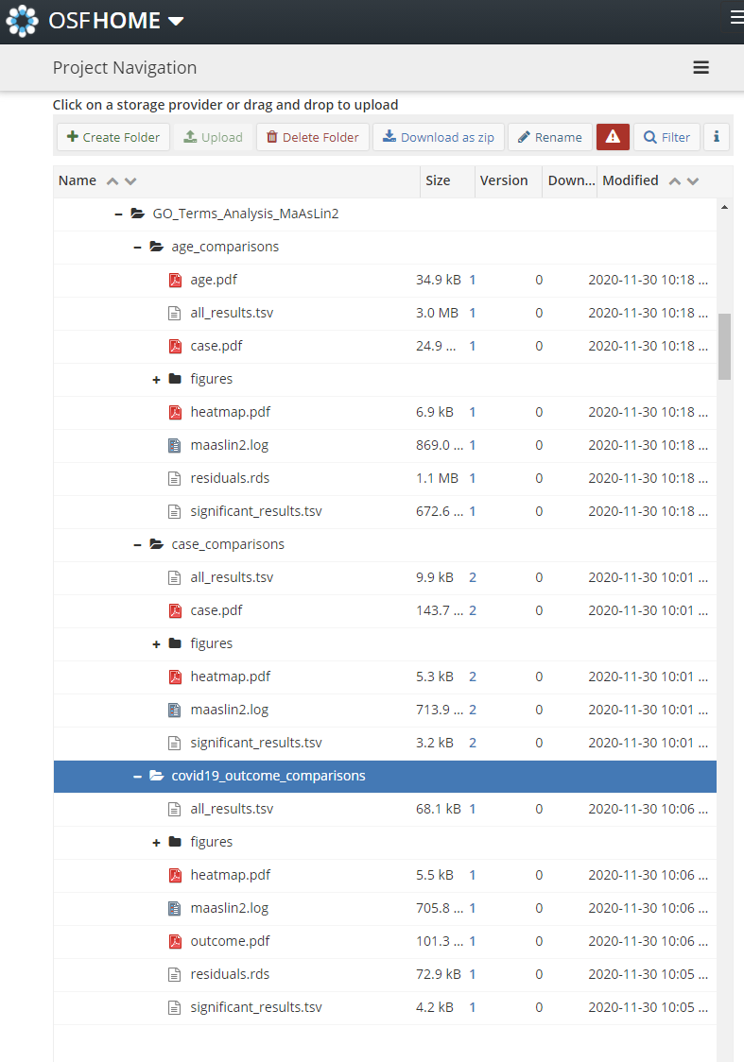
Overview of update
Updated results are in OSF
Issues
Remarkable Findings
Next Steps

Slide 3
Issues
Issue
Michalovic samples are all batching
Background:
I split the CAP samples from the rest of the Control Sick samples because beth asked me to.
This was really smart because the CAP were really different than the other Control sick cases.
The results from this delineation greatly improved the maaslin2 and dmm modeling, and yielded more insightful comparisons.
It also now shows a strong batch effect with the Michalovic samples
The Michalovich samples also now represent the VAST majority of the control sick samples, which was impairing the model, which is impairing the analyses.
Resolution
Because the CAP samples now provide a closer representation of a “no COVID19 but sick” treatment group, I decided to try removing the I removed the Control Sick cases from the analysis pipeline and the results look much cleaner (modeling and multivariate)
Issue
The VST normalization wasn’t normalizing
Resolution
I wasn’t giving the command to actually conduct the VST normalization
Issue
The VST normalization works too well
The differences observed in the dataset are in a count range from 1 to max 14, but most of the are between X and 1
I can't figure out how to not get >500 hits with the vst physeq object
Also, the results from the VST physeq has everything wayyy up compared to COVID19.
I think we could take these results and then go make boxplots of the compositionally transformed counts
Resolution
I decided to not use VST normalization and went ahead and just did a compositional transformation followed by a CLR normalization from the maaslin2 tool internally and got great results

Slide 4
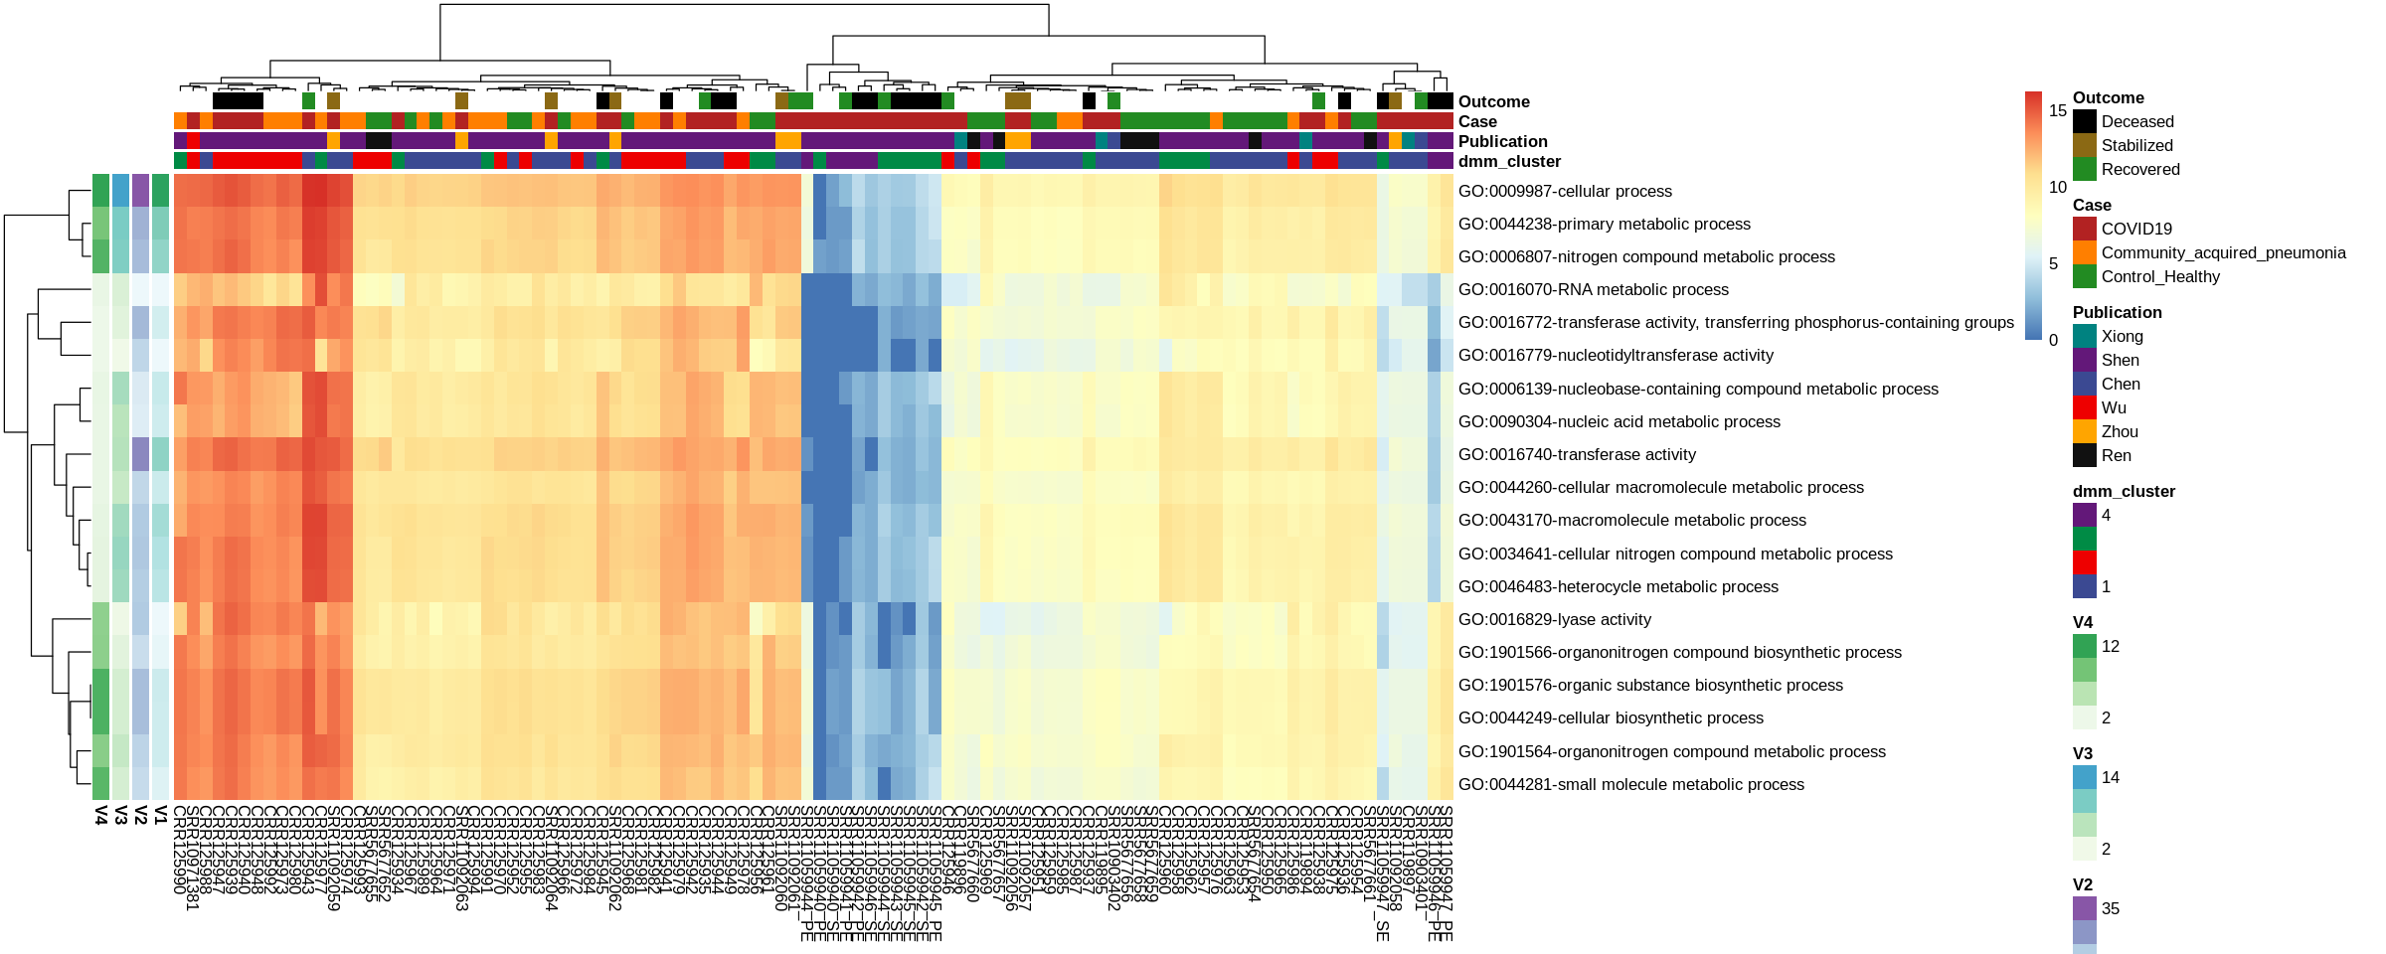
Open the html jupyter notebook

Slide 5
Open the html jupyter notebook

Slide 6
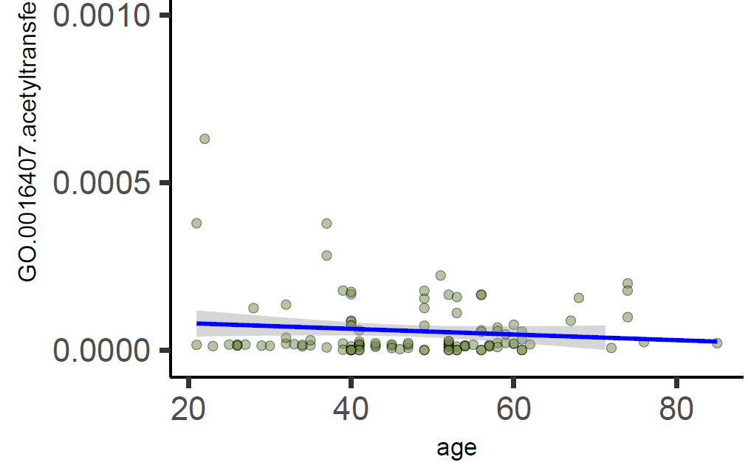
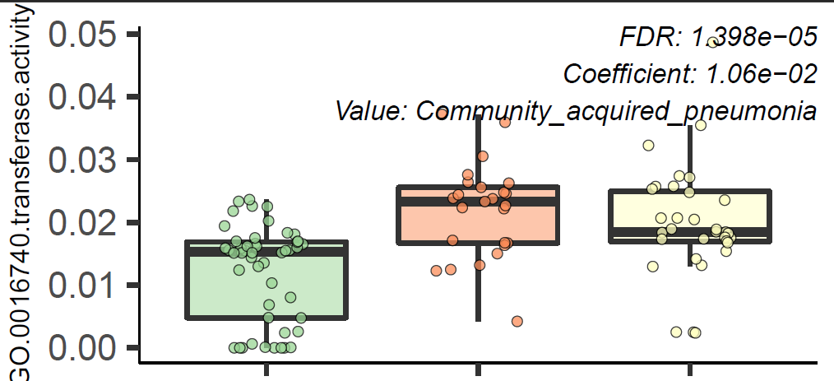
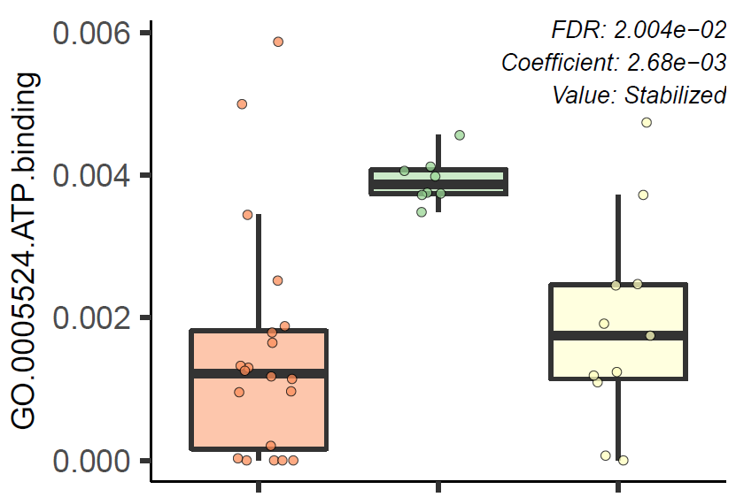
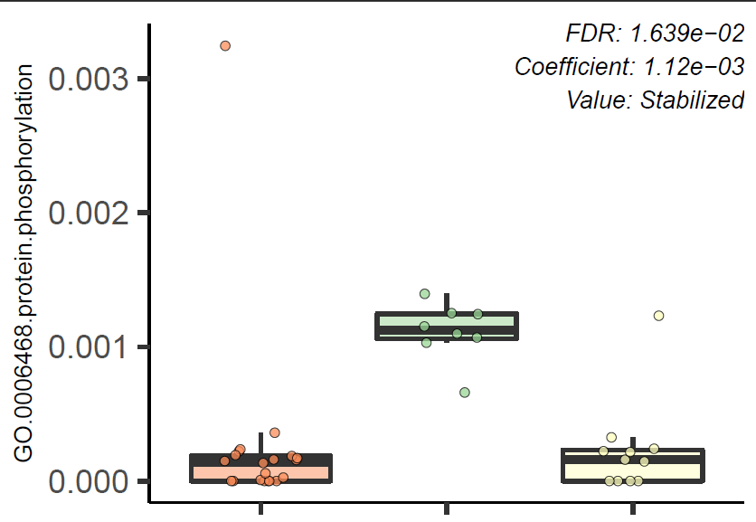
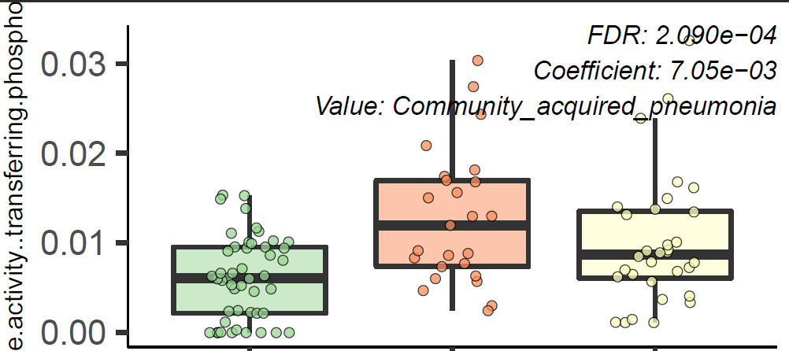
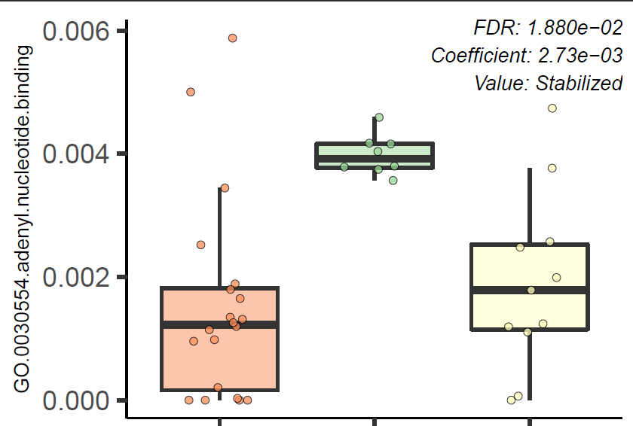
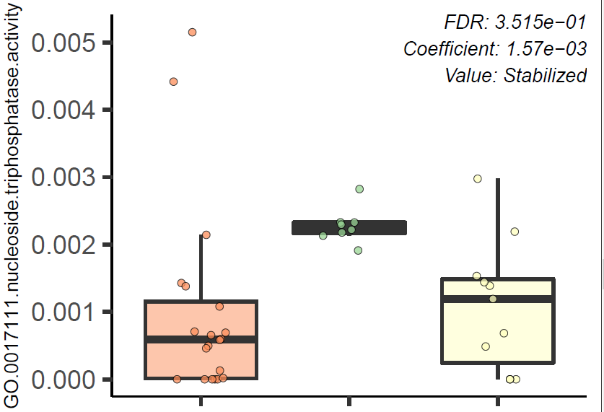
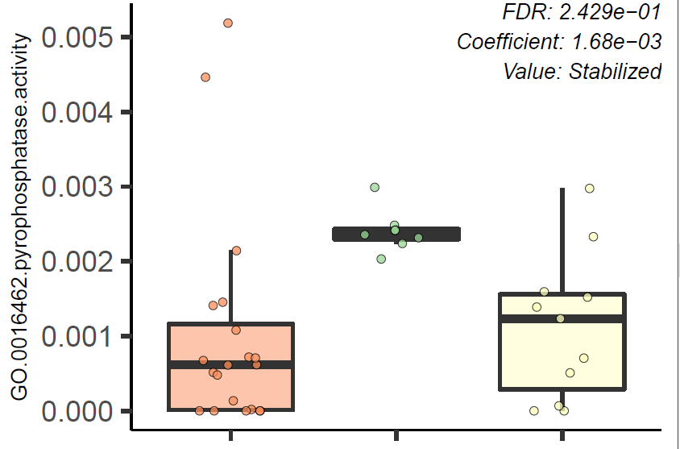
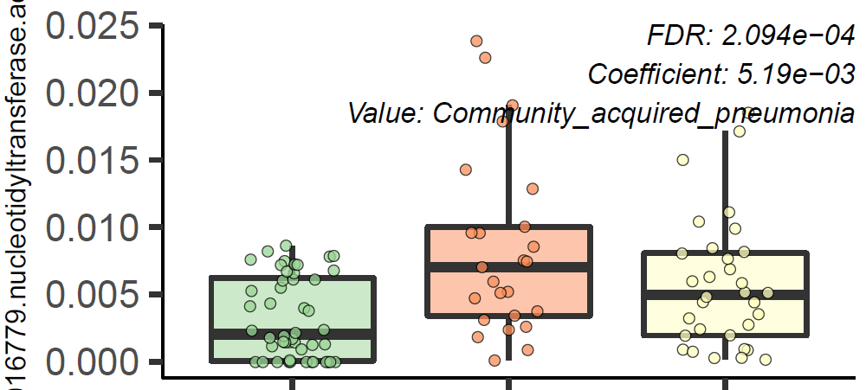
Remarkable findings
COVID19 (n=48)
Acetyl transferase activity
CAP (n=25)
Healthy (n=32)
So I was taking a look at the ~ top 10 sig. associated GO Terms for case, outcome, and age comparisons, and I noticed the terms “transferase”, “phosphate”, ”adenyl”, and “nucleotide” were very abundant.
transferase activity
age
ATP binding
Protein phosphorylation
Deceased (n=20)
transferase activity transferring phosphate
Stabilized (n=8)
Recovered (n=11)
Nucleoside triphosphatase activity
Adenyl nucleotide binding
Phosphatase activity
nucleotidyltransferase activity

Slide 7
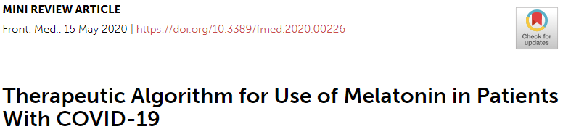
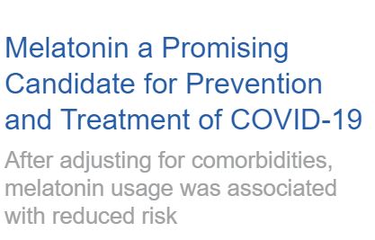
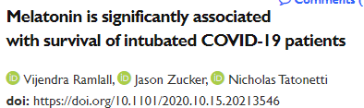
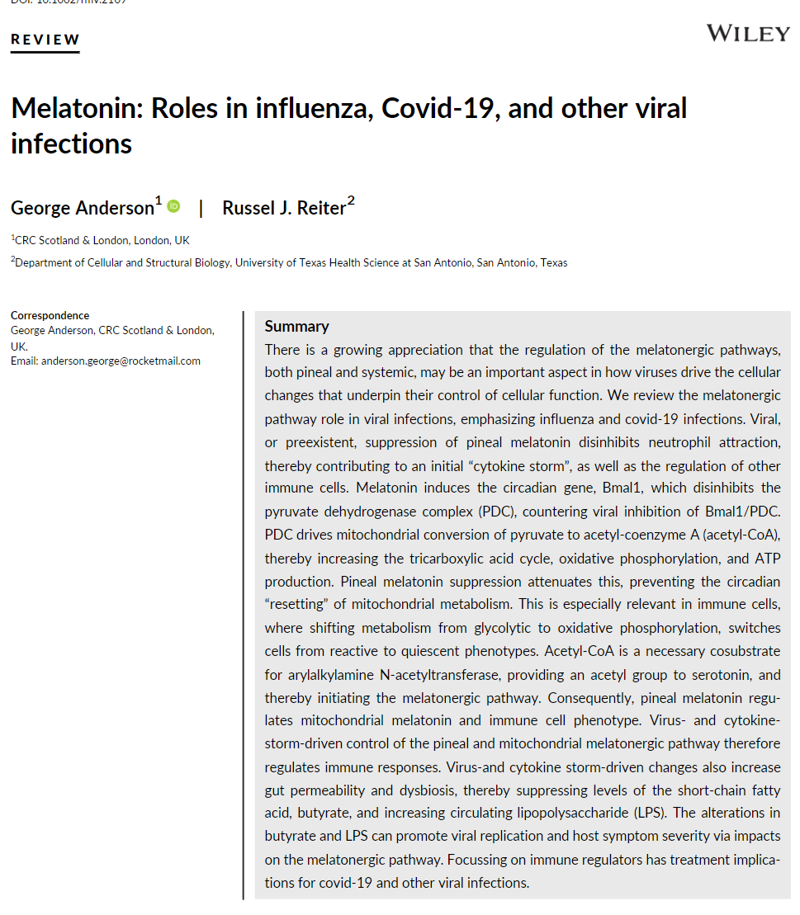
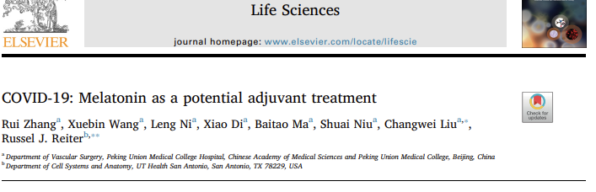
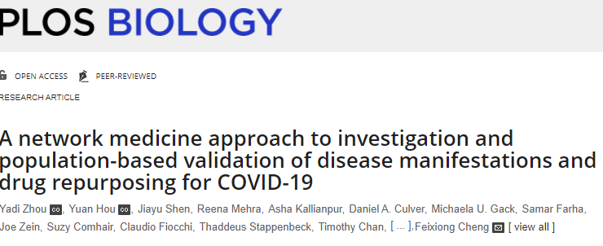
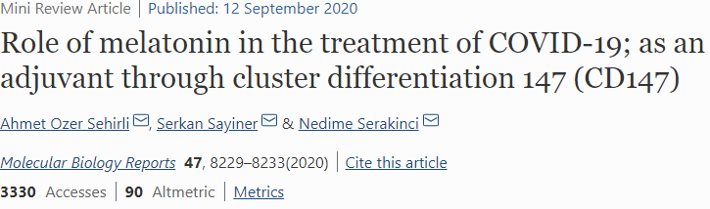
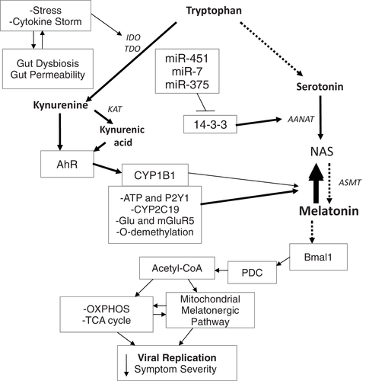
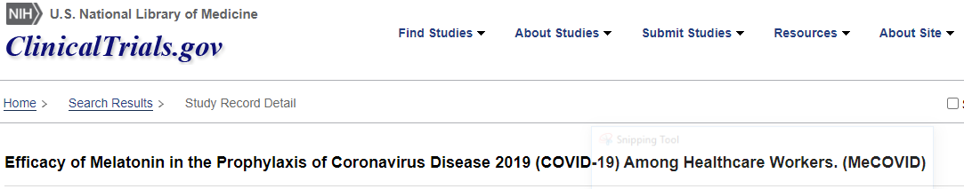
Virus& cytokine‐storm‐driven control of pineal and mitochondrial melatonergic pathway regulates immune responses
Viral, or preexistent, suppression of pineal melatonin disinhibits neutrophil attraction, thereby contributing to an initial “cytokine storm”, as well as the regulation of other immune cells.
Melatonin induces Bmal1 which disinhibits the PDC, countering viral inhibition of Bmal1/PDC.
Acetyl‐CoA is essential cosubstrate for arylalkylamine N‐acetyltransferase, providing an acetyl group to serotonin, and thereby initiating the melatonergic pathway.
Consequently, pineal melatonin regulates mitochondrial melatonin and immune cell phenotype.
Possible treatment implications for COVID‐19
Notes:
FIGURE 1Open in figure viewerPowerPoint
The cytokine storm and stress can increase gut dysbiosis/permeability, further contributing to cytokine induced IDO and TDO, leading to kynurenine and kynurenic acid, which activate the AhR to increase CYP1B1 and regulate the NAS/Melatonin ratio. Other factors, including CYP2C19, mGluR5, P2Y1, and O‐demethylation can also regulate the NAS/melatonin ratio. The miRNAs, miR‐7, miR‐375, and miR‐451 are increased following many viral infections, thereby suppressing 14‐3‐3 and the stabilization of AANAT, leading to melatonergic pathway inhibition. The suppression of melatonin, including from an increase in the NAS/melatonin ratio, attenuates melatonin's induction of Bmal1 and therefore the circadian regulation of mitochondria. Bmal1 induces PDC, leading to an increase in OXPHOS, the TCA cycle and the acetyl‐CoA that is a necessary co‐substrate for AANAT and melatonergic pathway activation. The decrease in pineal and mitochondrial melatonin contributes to an increase in the replication and severity of many viral infections. The arrows indicate “stimulation”, with a crossed‐line indicating “inhibitory”
https://onlinelibrary.wiley.com/doi/full/10.1002/rmv.2109#:~:text=Melatonin%20is%20actively%20inhibited%20by,associated%20with%20viral%E2%80%90linked%20fatality.
Viral, or preexistent, suppression of pineal melatonin disinhibits neutrophil attraction, thereby contributing to an initial “cytokine storm”, as well as the regulation of other immune cells.
Melatonin induces the circadian gene Bmal1 which disinhibits the PDC, countering viral inhibition of Bmal1/PDC.
PDC drives mitochondrial conversion of pyruvate to acetyl‐coenzyme A (acetyl‐CoA), thereby increasing the tricarboxylic acid cycle, oxidative phosphorylation, and ATP production.
Pineal melatonin suppression attenuates this, preventing the circadian “resetting” of mitochondrial metabolism.
This is important in immune cells shifting glycolytic to oxidative phosphorylation metabolism which switches cells from reactive to quiescent.
Acetyl‐CoA cosubstrate for arylalkylamine N‐acetyltransferase, providing an acetyl group to serotonin, and thereby initiating the melatonergic pathway.
Consequently, pineal melatonin regulates mitochondrial melatonin and immune cell phenotype.
Virus‐and cytokine storm‐driven changes also increase gut permeability and dysbiosis, thereby suppressing levels of the short‐chain fatty acid, butyrate, and increasing circulating lipopolysaccharide (LPS).
The alterations in butyrate and LPS can promote viral replication and host symptom severity via impacts on the melatonergic pathway.
Possible treatment implications for covid‐19 and other viral infections.
Also cd147 hypothesis
CD147 protein and the potential protective effect of melatonin that is mediated by this protein in COVID-19. CD147 is a glycoprotein that is responsible for the cytokine storm in the lungs through the mediation of viral invasion. Melatonin use previously was shown to reduce cardiac damage by blocking the CD147 activity.

Slide 8
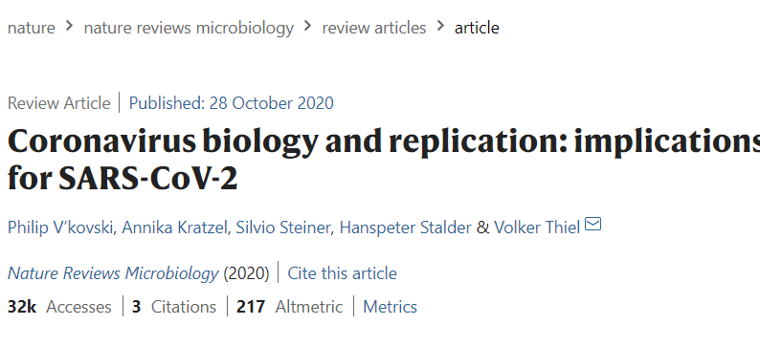
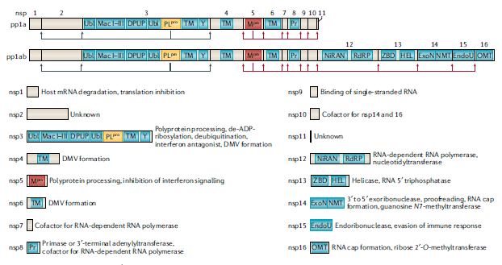
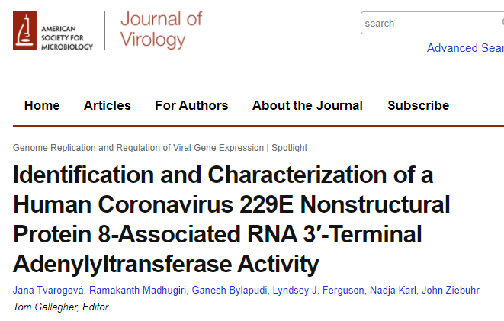

Possible orf8 relationship
RNA synthesis is performed by the nsp12 RNA- dependent RNA polymerase (RdRP) and its two cofactors nsp7 and nsp8, the latter with proposed primase or 3′- terminal adenylyltransferase
found that the protein has metal ion-dependent RNA 3′-terminal adenylyltransferase (TATase) activity while other nucleotides were not (or very inefficiently) transferred to the 3′ ends of single-stranded and (fully) double-stranded acceptor RNAs.
Possible that nsp8-mediated TATase activity is involved in the 3′ polyadenylation of viral plus-strand RNAs. (unconfirmed)
Notes:
https://www.cell.com/structure/fulltext/S0969-2126(05)00313-8?_returnURL=https%3A%2F%2Flinkinghub.elsevier.com%2Fretrieve%2Fpii%2FS0969212605003138%3Fshowall%3Dtrue
https://onlinelibrary.wiley.com/doi/10.1002/jmv.25719
https://www.ncbi.nlm.nih.gov/pmc/articles/PMC7103355/

Slide 9
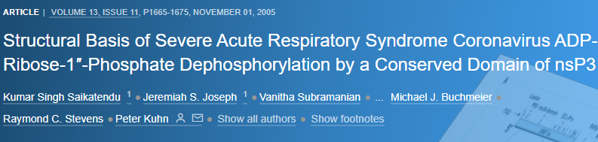
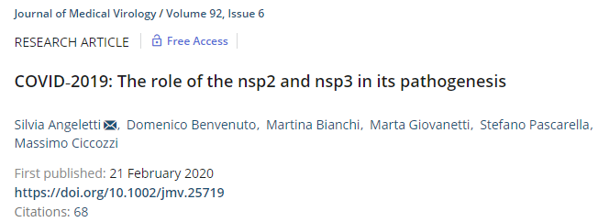
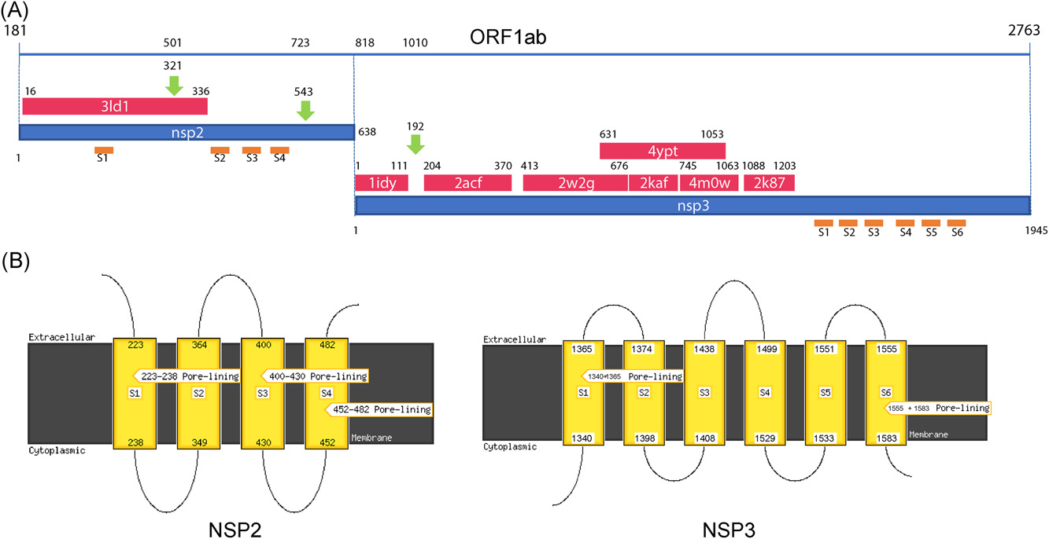
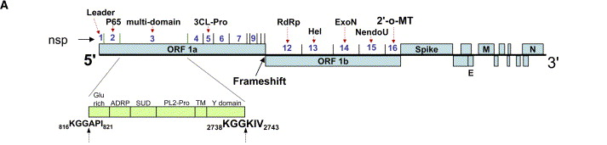
The crystal structure of a conserved domain of nonstructural protein 3 (nsP3) from severe acute respiratory syndrome coronavirus (SARS-CoV) The putative active site is a solvent-exposed
three structural homologs,
yeast Ymx7,
Archeoglobus fulgidus AF1521,
Er58 from E. coli.
Homologs acts on ADP-ribose-1″-phosphate (Appr-1″-p).
The SARS nsP3 domain readily removes the 1″ phosphate group from Appr-1″-p in in vitro assays, confirming its phosphatase activity.
Sequence and structure comparison suggests that proteins of this superfamily form an emerging group of nucleotide phosphatases that dephosphorylate Appr-1″-p.
“Destabilizing mutation of nsp3 protein could explain the difference observed between SARS and COVID‐19.”
https://onlinelibrary.wiley.com/doi/10.1002/jmv.25719
https://www.cell.com/structure/fulltext/S0969-2126(05)00313-8?_returnURL=https%3A%2F%2Flinkinghub.elsevier.com%2Fretrieve%2Fpii%2FS0969212605003138%3Fshowall%3Dtrue
Notes:
https://www.cell.com/structure/fulltext/S0969-2126(05)00313-8?_returnURL=https%3A%2F%2Flinkinghub.elsevier.com%2Fretrieve%2Fpii%2FS0969212605003138%3Fshowall%3Dtrue
https://onlinelibrary.wiley.com/doi/10.1002/jmv.25719
The crystal structure of a conserved domain of nonstructural protein 3 (nsP3) from severe acute respiratory syndrome coronavirus (SARS-CoV) has been solved by single-wavelength anomalous dispersion to 1.4 A resolution. The structure of this "X" domain, seen in many single-stranded RNA viruses, reveals a three-layered alpha/beta/alpha core with a macro-H2A-like fold. The putative active site is a solvent-exposed cleft that is conserved in its three structural homologs, yeast Ymx7, Archeoglobus fulgidus AF1521, and Er58 from E. coli. Its sequence is similar to yeast YBR022W (also known as Poa1P), a known phosphatase that acts on ADP-ribose-1''-phosphate (Appr-1''-p). The SARS nsP3 domain readily removes the 1'' phosphate group from Appr-1''-p in in vitro assays, confirming its phosphatase activity. Sequence and structure comparison of all known macro-H2A domains combined with available functional data suggests that proteins of this superfamily form an emerging group of nucleotide phosphatases that dephosphorylate Appr-1''-p.

Slide 10
TODO
library(decontam)
Have we done any contamination control so far in the processing pipe?
(does this even work on the GO TERMS)
Should I do it with all the samples or only the samples from the pub they came from
Clearly ascertain the original authors criteria
"Control Sick"
“Community acquired pneumonia"
inclusion and the all the devilish who, what, how, why details that accompany
exclusion, and similarly detailed.
Rationale
The reason is that this assures that the population heterogeneity is not too great. If it is too great, then we have to do different stratification to control
Results interpretation discussion
Lit review, supporting papers, etc.
WRITE!
Notes:
https://watermark.silverchair.com/ciaa203.pdf?token=AQECAHi208BE49Ooan9kkhW_Ercy7Dm3ZL_9Cf3qfKAc485ysgAAAtgwggLUBgkqhkiG9w0BBwagggLFMIICwQIBADCCAroGCSqGSIb3DQEHATAeBglghkgBZQMEAS4wEQQMKdbj-EdyN3Dlw6K4AgEQgIICi4BsQuJS5dsmkYpkBW5i7gnPrrawkZWVX92Dl3_ujOP3dbwHo181tV4ln2Ze2GgABfuVhfhDrcXNaAKBS2azd-zayz-RU641HNuHooJdan_1xCT1yGsp3VXKa7kQH9OUhzqfBhUU4z7q5bn72q8YjSa9KNvrNCx8NfJI-Mob_YBQHnQD4I6Acasu3Z63IXxpCMtziAIUNyadj93DIrsAO8GU6YI5ENxx8XG-XfID_zfy6rCM7oe9MAR3eD-YyM05ylJAhLkNLspRknr0UCQOXfxkqPTbhsj9bYyhACwClR4XNgBmufXOkHlJ6Jdcja5ZUA88fcG4lNHn4HmBtIASfCUmRzweYV-4zQEJUt_HeLeXyRxcSJgi6n46Mv7E9hTmHdWmU69-llKWmMcAepdABv2AZAVXT9He6zdCbKdDzykq-ngoYD6FZyIUjx1A37Z2qem4C9Mx9GrGT0Y14FYajVv9mWSYA2Y5FAtLzKaTINGutrBfvlM7a2xU6S066_XVqWW5VzKdUiCu8dwA97INo3pWjpFkebnYdrsLz0njvTLSwp8febsxL8PDAnMtzNyyNM_Q5VR0A30ytZxeCM5nDSvHX_roHwGRLYMrbPL-cT6XoxrL4UY87C4Dt0UzcKtyq20Da5_iI92lej5IZXiZkdFHTYVcBvhttzHPWaaC-X9iooJvS-cptvHQUOOYICFMNX6KpaHB_98ktYMmiJ1vC9sD-1W6nfpehWkx8V90SuiEqSBeKQ7LOm3hm6OfUiwkEpd4vOh31agUWIwBY26J6opU3NEnlTbNTn7-iMXkAi76-hFKZ0OyDr3YObcisIj8f58pYaC72Q7b82wGyAdI-GZwjkROqO9_2HAj0Q

Slide 11
Tables and Figures
24 November 2020
Jochum, Michael D.

Slide 12
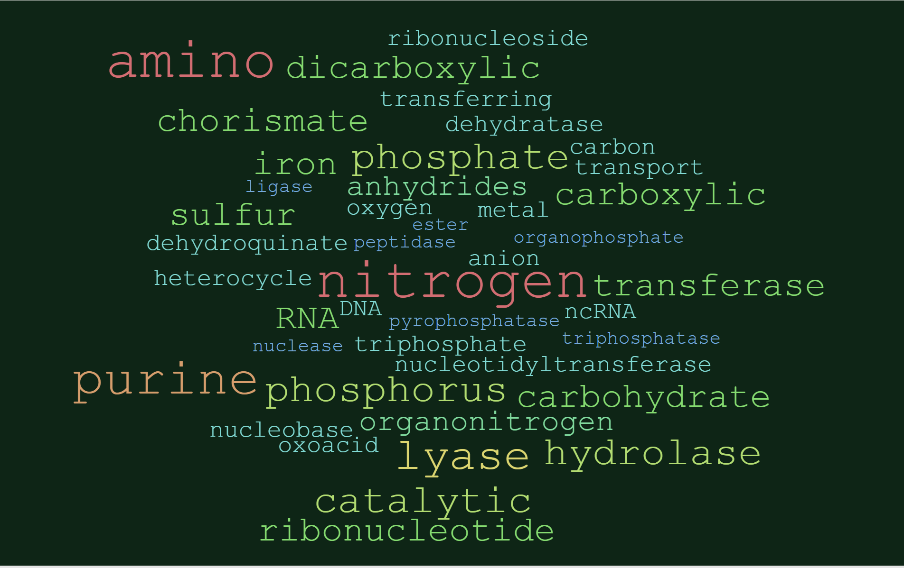
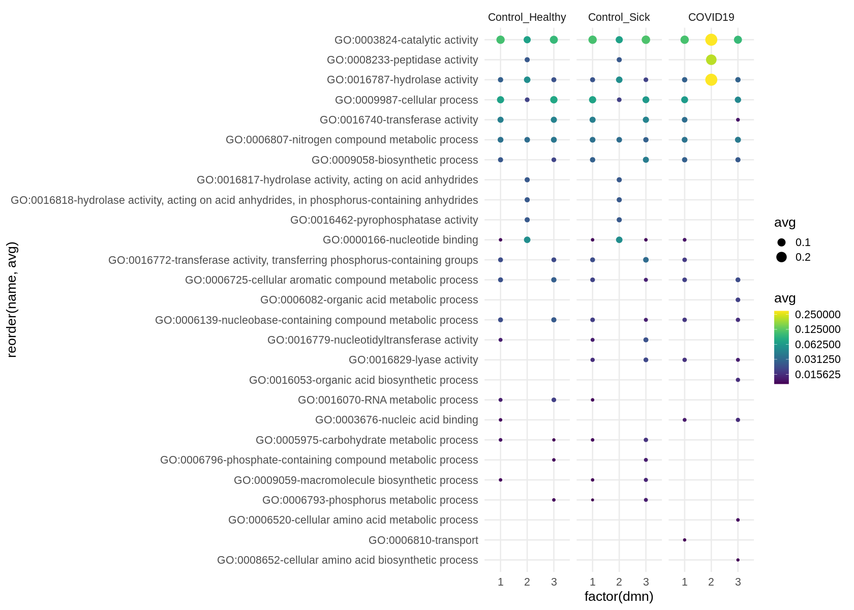

Slide 14
Table 1. Overview of Meta-analysis dataset Clinical Characteristics
Categorical, n (%) | Community acquired pneumonia | Control Healthy | Control Sick | COVID19 | p- value
case | 25 (17.7%) | 32 (22.7%) | 36 (25.5%) | 48(34%) | TBD
Sex
female | 8 (32%) | 6 (18.8%) | 24 (66.7%) | 16 (33.3%) | TBD
male | 11 (44%) | 6 (18.8%) | 12 (33.3%) | 32 (66.7%) | TBD
unspecified | 6 (24%) | 20 (62.5%) | 0 (0%) | 0 (0%) | TBD
origin | FIX THIS LATER | FIX THIS LATER | FIX THIS LATER | FIX THIS LATER | TBD
smoking status
yes | 0 (0%) | 1 (3.12%) | 13 (36.1%) | 0 (0%) | TBD
no | 0 (0%) | 3 (9.38%) | 0 (0%) | 0 (0%) | TBD
unspecified | 25 (100%) | 28 (87.5%) | 23 (63.9%) | 48 (100%) | TBD
Reads |  |  |  |  | TBD
paired | 25 (100%) | 32 (100%) | 0 (0%) | 32 (66.7%) | TBD
single | 0 (0%) | 0 (0%) | 0 (0%) | 16 (33.3%) | TBD
unspecified | 0 (0%) | 0 (0%) | 36 (100%) FIX THIS LATER | 0 (0%) | TBD
Publication
Chen | 0 (0%) | 0 (0%) | 0 (0%) | 2 (4.2%) | TBD
Michalovich | 0 (0%) | 3 (9.4%) | 36 (100%) | 0 (0%) | TBD
Ren | 0 (0%) | 9 (28.1%) | 0 (0%) | 0 (0%) | TBD
Shen | 25 (100%) | 20 (62.5%) | 0 (0%) | 32 (66.7%) | TBD
Wu | 0 (0%) | 0 (0%) | 0 (0%) | 1 (2.1%) | TBD
Xiong | 0 (0%) | 0 (0%) | 0 (0%) | 4 (8.3%) | TBD
Zhou | 0 (0%) | 0 (0%) | 0 (0%) | 9 (18.8%) | TBD
Numeric, mean ± SD (n)
Age | 51.1 ± 19.8 (n=17) | 49.8 ± 13.9 (n=12) | 43 ± 11.3 (n=36) | 47.9 ± 10.4 (n=48) | TBD
Temp. °C | 38.4 ± 0.91 (n=15) | - | - | 38.4 ± 0.715 (n=8) | TBD
days after onset | 9.07 ± 3.17 (n=14) | - | - | 12.05 ± 6.5 (n=41) | TBD
Suppl. Table 1. COVID19 Sample Characteristics
outcome | n (%) | p-value
Deceased | 20 (41.7%) | TBD
Recovered | 11 (22.9%) | TBD
Stabilized | 7 (16.7%) | TBD
Unspecified | 9 (18.8%) | TBD
Cough
aggravated | 1 (2.1%) | TBD
expectoration | 3 (6.3%) | TBD
intermittent | 2 (4.2%) | TBD
yes | 6 (12.5%) | TBD
Unspecified | 36 (75%) | TBD
days delayed hospital mean ± SD (n) | 5.27 ± 3.29 (n=11) | TBD
Suppl. Table 2. Control Sick Sample Characteristics
Sample Type | n (%) | p-value
Asthma | 7 (19.4%) | TBD
Asthma_Ex_smoker | 3 (8.3%) | TBD
Asthma_Smoker | 2 (5.6%) | TBD
Obese | 6 (16.7%) | TBD
Obese_Asthma | 9 (25%) | TBD
Obese_Asthma_Smoker | 1 (2.8%) | TBD
Obese_Smoker | 5 (13.9%) | TBD
Smoker | 3 (8.3%) | TBD

Slide 15
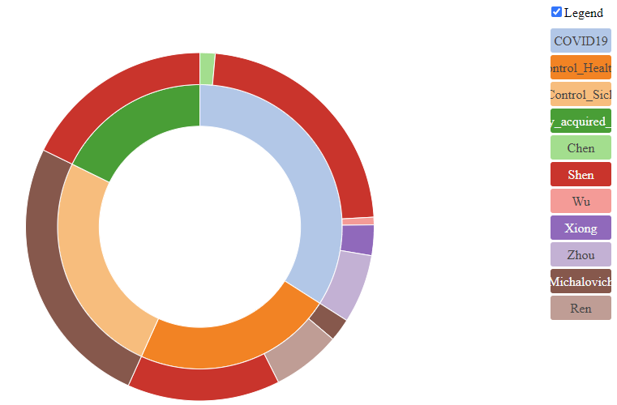
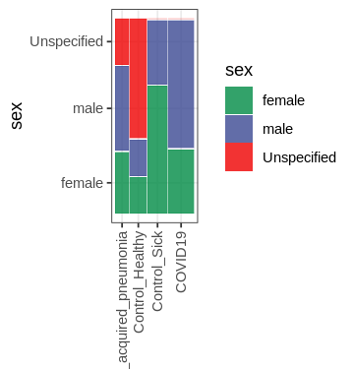
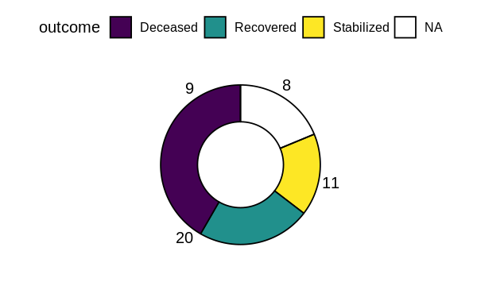
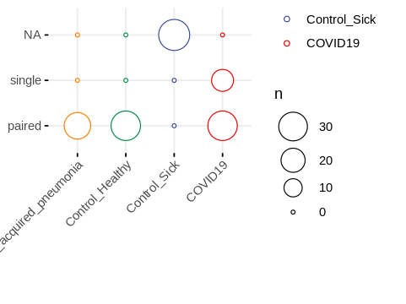
hyperlink

Slide 16
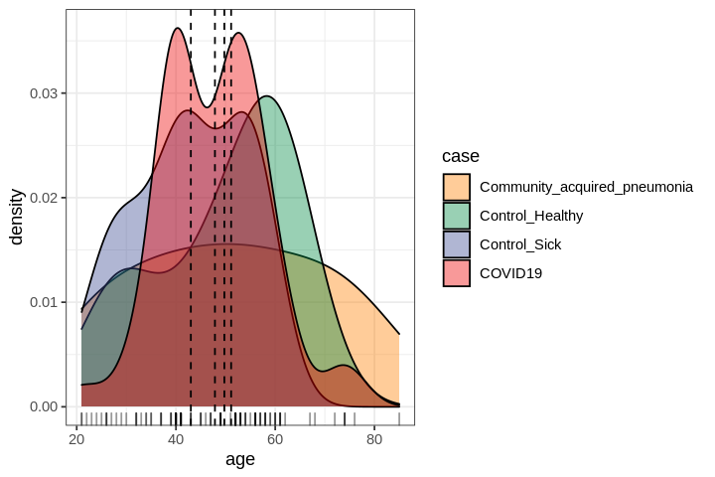
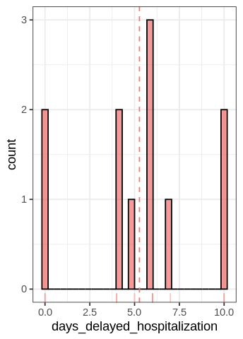
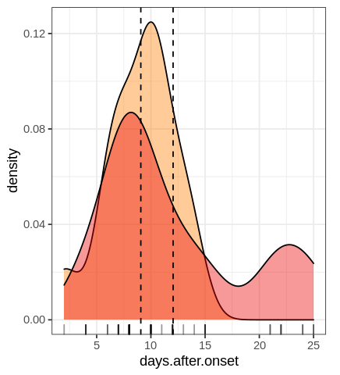
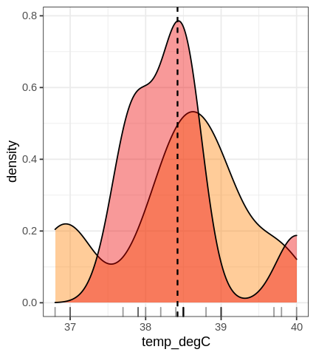

Slide 17
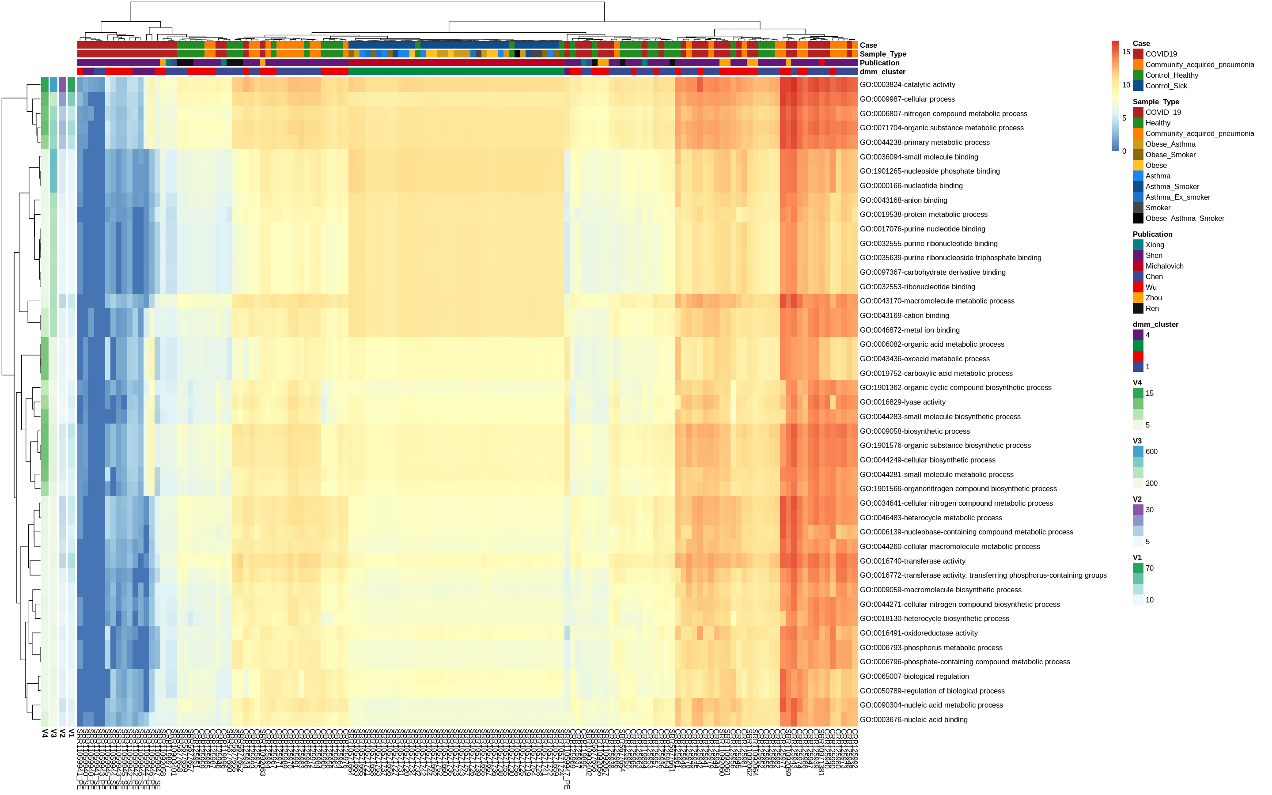

Slide 18
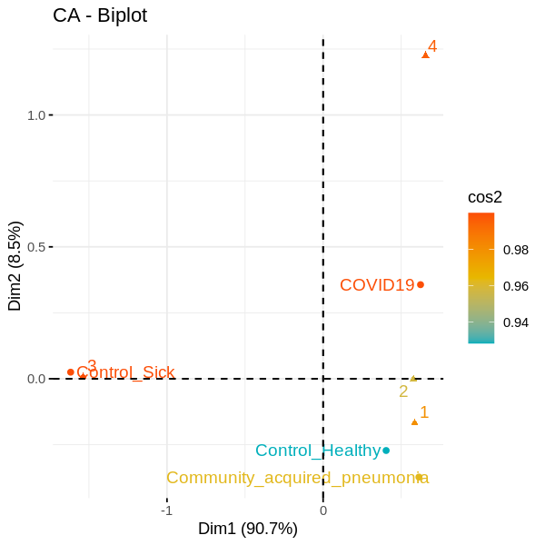

Slide 19
